Slide 1
Monday Morning Managers
Leadership Qualities and Career Pathways: An Exploratory Study
Paper Presented at the 27th Annual Conference of the Network for Social Work Management
June 17, 2016
Linda Helm, MSW, PhD Richard Boettcher, MSW, PhD
This paper is a draft and not intended, in its present form, for duplication or publication. However, permission to cite or quote from its contents is freely given by the authors

Slide 2

Mixed Methods Study of the First 50
Monday Morning Managers Blog
Purpose of Study
To determine:
Preferred Leadership Qualities
Motivational Strategies
Career Paths to Management
Advice to Future Leaders
Paucity of research- Blog shines
light on what social work managers do

Slide 3
Methodology
Pilot Study Data Collection Form
Separate Readings Collaboration
Quantitative data entered into SPSS
Qualitative data subjected to thematic analysis through collective comparison method
Collaborative Time= 15 + hours
Individual Time= 25 hours each

Slide 4
Quantitative Findings
Small sample of convenience (n=50)
Observations and hypotheses, Not hard conclusions
General findings
Monday Morning Managers are:
Likeable ☺
Positive-minded ☺
Affirming in their attitudes towards work
and profession ☺
Autobiographical essays are uplifting ☺
A cogent argument for why we need social workers to manage Human Service Organizations ☺

Slide 5

Summary of Demographic and Descriptive Data (n=50)
Gender Degrees PhD Years in Mang. Licensed? M W NonSW BSW MSW + SW NonSW >10 4-9 1-3 Yes Unk. 17 33 1 8 41 9 3 27 17 4 21 29
Current and Previous Positions in Human Service Organizations
Current Previous Executive Director 17 14 Middle Manager 26 31 Frontline Supervisor 5 21 Staff Specialist 2 Clinician 0 37

Slide 6

Years in Management and Level of Current Position (n=50)
Years in Management | Current Position Level
1-3 Years 4-9 Years 10+ Years | Front Line Middle Manager Executive Supervision or Staff Specialist Director
 | f (%) f (%) f (%) | Total
 | 1 (20%) 5 (18%) 0 (0%) 4 (80%) 8 (29%) 5 (29%) 0 (0%) 15 (53%) 12 (71%) | 6 17 27
Totals | 5 (100%) 28 (100%) 17 (100%) | 50

Slide 7
Paths to Management
Subjects Paths to Management (n=50)
Frequency % Under Graduate or Graduate degree in Social Work Direct Service to First Management 33 66.0 U/G or G degree Not in SW Direct Service to First Management 2 4.0 UG or G degree in SW First Management 12 24.0 Other Path 1 2.0 Indeterminate 2 4.0___ Total 50 100.0

Slide 8
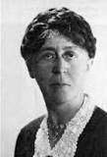
Favored Focus of Leadership
Favored Focus of Leadership Favored by Subjects (n=50)
Frequency % Focus primarily on aspects of expressed Personality and/or Style 13 26.0 Passion, Project Vision, Creativity, Collaborative Style, Trustworthiness, Organized, Efficient Focus primarily on aspects of Organizational Culture, Structure or Process 10 20.0 Alliance Building, Staff development, Creating Shared Vision, Collaborative Decision Making and/or Problem Solving Both 26 52.0 Unclassifiable 1 2.0___ Total 50 100.0
Mary Parker Follett

Slide 9
Favored Approaches to Motivating Staff
Subjects Favored Approaches to Motivating Staff (n=50)
Frequency % Primarily through Personal Interaction 6 12.0 Praise, Recognition, Brainstorming Collaboratively, Positive Affirmation Primarily through Structural Arrangements 15 30.0 Focus on Team to support each other, Focus on Individualized Professional Development, Empower staff to work independently, Create Monitoring and Communication Systems to Support Self-Motivation Both 25 50.0 None: staff self motivates 3 6.0 Unknown 1 2.0___ Total 50 100.0

Slide 10
Locus of Primary Mentors who Guided Subjects to Leadership Roles
Locus of Primary Mentors Who Have Guided Subjects to Leadership Roles? (n=50)
Frequency % Work Related Director or Supervisor 21 42 College Professor 4 8 College Field Instructor/Supervisor 1 2 Some Combination of Work and School 14 28 Other 4 8 Not Declared or indeterminate 6 12__ Total 50 100

Slide 11
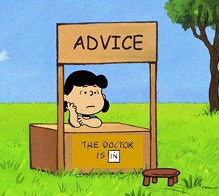
Qualitative Findings
WHAT ADVICE DO YOU HAVE FOR THOSE BEGINNING THEIR CAREER AND/OR WHAT DO YOU WISH YOU HAD KNOWN BEFORE YOU STARTED YOUR CAREER?
Advice of a Personal Nature | Advice of a Professional Nature | Advice of an Organizational Processes/Dynamics Nature
The Character of the Leader | Communication | Internal
Self-care and Development | Leadership | External
 | Professional Development
 | Skills and Knowledge
 | Networking and Partnership

Slide 12
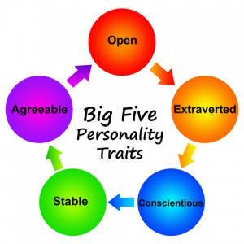
Inferred “BIG 5” Personality Traits
Subjects Self-Identified “Big 5” Personality Traits, Directly or Inferred
Percent of 50 Subjects Open: Seeks new experience 96% (n=48) Extraverted / Introverted Impossible to Determine Conscientiousness 58% (n=21) Emotional Stability Impossible to Determine Agreeable 64% (n=32)

Slide 13
Observations/ Hypotheses for Future Research
18% of Monday Morning Managers report affiliation with proprietary agencies.
Confirmed by other research.

Slide 14
Observations/ Hypotheses for Future Research
66% of Monday Morning Managers report having direct practice employment before management.
24% go directly into management

Slide 15
Observations/ Hypotheses for Future Research
36% of Monday Morning Managers without direct practice experiences tend to favor an organizational approach to leadership
60% of those with direct practice experience tend to favor BOTH (organizational and interpersonal) approaches to leadership

Slide 16
Observations/ Hypotheses for Future Research
Monday Morning Managers
with and without
Direct Practice experience favor using BOTH (personal interaction and organizational approaches) to motivate staff

Slide 17
Observations/ Hypotheses for Future Research
The workplace, not school, is the primary source of mentorship for Monday Morning Managers who came to leadership positions after significant direct practice experience (59%)
For those coming into leadership roles directly from school tend to identify mentors associated with schools

Slide 18

Observations/ Hypotheses for Future Research
The presence of three of the “BIG 5” personality characteristics was inferred from the Monday Morning Managers Blog
Conscientiousness
Open
Agreeable

Slide 19


Observations/ Hypotheses for Future Research
The Character of the Leader
and
are important to effective

Slide 20
Observations/ Hypotheses for Future Research
Social Work Managers require:
non-profit management acumen including entrepreneurial skills
program development and evaluation knowledge
skill in managing interactions between their organizations and the larger systems of governance, financing, and collaborative problem solving

Slide 21
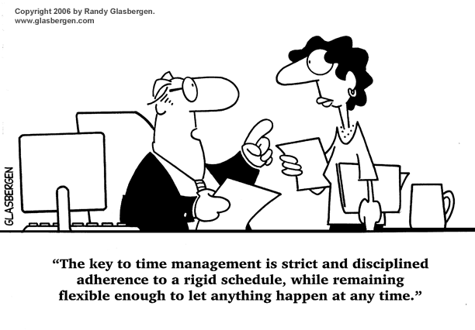
Thank You
Any Comments, Questions, Thoughts?

